Slide 1
01 | Classification
Cynthia Rudin | MIT Sloan School of Management

Slide 2
Classification
Recap of Classification
Loss Functions for Classification
Statistical Learning Theory for Supervised Learning
Basic Outline for ML
Logistic Regression
Evaluation Measures for Classifiers
Confusion Matrix, Accuracy, TPR, FPR, Precision, Recall, F1-score
ROC curves and the AUC/AUROC

Slide 3
Classification
Each observation is represented by a set of numbers (features).
Manhole is represented as: [ 5 3 120 12 1 0 ….. ] -1
[ 0 0 89 5 1 1 ….. ] 1
[ 1 0 20 0 0 1 ….. ] -1
: :
Features, called X
Labels, called Y
Notes:
*read* and each observation is labeled.

Slide 4
Classification
Each observation is represented by a set of numbers (features).
Manhole is represented as: [ 5 3 120 12 1 0 ….. ]
Inspected?
Vented cover?
Number of events last year
Number of electrical cables
Number of serious events last year
Number of pre-1930 electrical cables
Notes:
In the running example, each manhole is represented as a vector of numbers where the features are …

Slide 5
Classification
Each observation is represented by a set of numbers (features).
Manhole is represented as: [ 5 3 120 12 1 0 ….. ]
Inspected?
Vented cover?
Number of events last year
Number of electrical cables
Number of serious events last year
Number of pre-1930 electrical cables
Feature data is from 2014 and before
(Label is 1, it exploded in 2013)
Notes:
The feature data is computed from year 2014 and before

Slide 6
Classification
Each observation is represented by a set of numbers (features).
Manhole is represented as: [ 5 3 120 12 1 0 ….. ]
Inspected?
Vented cover?
Number of events last year
Number of electrical cables
Number of serious events last year
Number of pre-1930 electrical cables
Feature data is from 2014 and before
(Label is 1 if it exploded in 2015)
Notes:
The label data is what happened in 2015 *read*.
Then when we get feature data from 2015, we use our model to predict what will happen in 2016.

Slide 7
Classification
Formally, given training set (x_{i,}y_{i}) for i=1…n, we want to create a classification model f that can predict label y for a new x.

Slide 8
Classification
Formally, given training set (x_{i,}y_{i}) for i=1…n, we want to create a classification model f that can predict label y for a new x.
Manhole is represented as: [ 1925 15]
Year oldest cable installed
Number of events last year
Notes:
Let’s again say that each manhole is represented by 2 features… which allows us to plot these points in the plane.

Slide 9
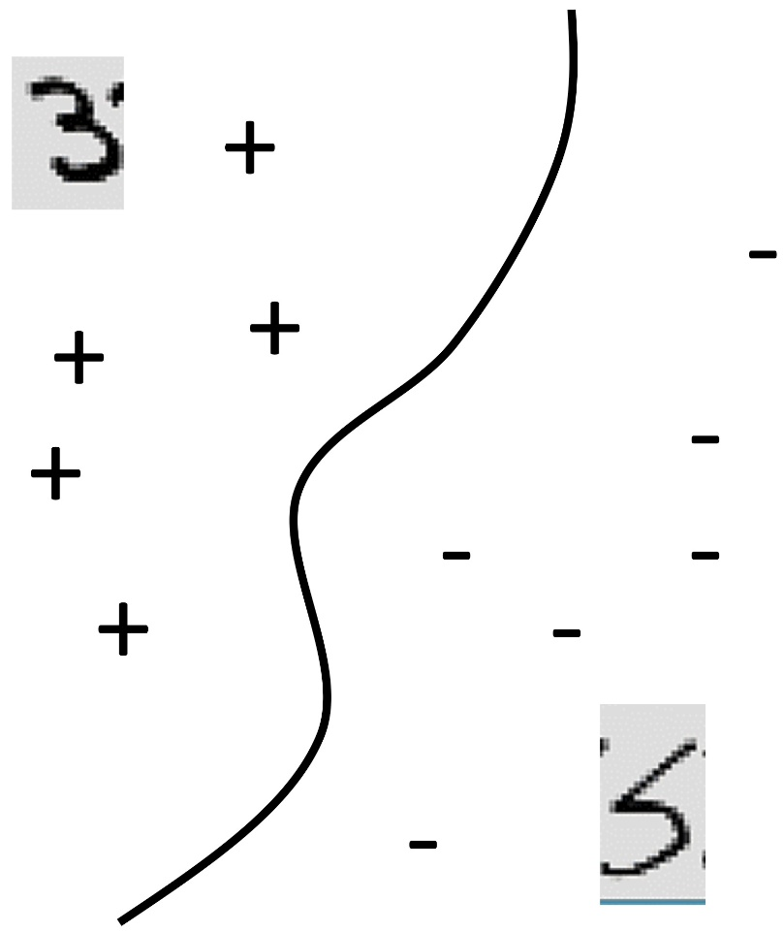
Classification
Formally, given training set (x_{i,}y_{i}) for i=1…n, we want to create a classification model f that can predict label y for a new x.
20
Manhole is represented as: [ 1925 15]
Events Last Year
Year oldest cable installed
Number of events last year
0
1925
Oldest cable
2015

Slide 10
Classification
Formally, given training set (x_{i,}y_{i}) for i=1…n, we want to create a classification model f that can predict label y for a new x.
20
f(x)>0
f(x)=0
f(x)<0
Manhole is represented as: [ 1925 15]
Events Last Year
Year oldest cable installed
Number of events last year
0
1925
Oldest cable
2015
Notes:
We want to create a function that is positive for manholes that did or will explode, and negative for manholes that didn’t or won’t explode. And the decision boundary is where f(x)=0.

Slide 11
Classification
Formally, given training set (x_{i,}y_{i}) for i=1…n, we want to create a classification model f that can predict label y for a new x.
20
f(x)>0
f(x)=0
f(x)<0
f(x) = function(Events Last Year, Oldest Cable)
Events Last Year
0
1925
Oldest cable
2015
Notes:
That function is going to eat the two features … and produce a number. We take the sign of the number, and that’s the predicted class. Give me a new example I’ve never seen before, you give me it’s feature vector, I plug those values into f, then I get a number. If it’s a positive number I predict an explosion, if it’s a negative number I predict no explosion.

Slide 12
Classification
Formally, given training set (x_{i,}y_{i}) for i=1…n, we want to create a classification model f that can predict label y for a new x.
The machine learning algorithm will create the function f for you.
The predicted y for a new x is the sign of f(x).
Notes:
So just to repeat
It might be very complicated, but the way to use is is not complicated:

Slide 13
Loss Functions for Classification

Slide 14
Loss Functions for Classification
How do we measure classification error?
Fraction of times sign(f(x_{i})) is not y_{i}
Notes:
*read*
Let’s give you the geometric picture here.
Classification algorithms try to find f that minimizes classification error. Unfortunately they can’t usually minimize this directly, because it is usually computationally hard. *click*

Slide 15
Loss Functions for Classification
How do we measure classification error?
Fraction of times sign(f(x_{i})) is not y_{i}
+
−
−
−
+
+
+
+
+
−
−
+
−
+
+
−
Notes:
Let’s give you the geometric picture here. The decision boundary is this line right here. F being positive is here, and f being negative is here. The red points are all misclassified. Now what I’m going to do is something you might not be expecting, which is that I’m going to move all the correctly classified points across the decision boundary to the left, and I’m going to map all the misclassified points to the right. *click* Ok, glad I did that, now I have the ones we got correct on the left and the ones we got wrong on the right. So the labels on this plots are wrong. We don’t have f<0 on the left and f>0 on the right. We have something like this. *click*. So on the left, either f is positive and y is also positive, so yf is positive, or we have y negative and f negative, so yf is again… positive. And on the right we have cases where the sign of f is different than y. And the ones I suffer a penalty for are the ones on the right.

Slide 16
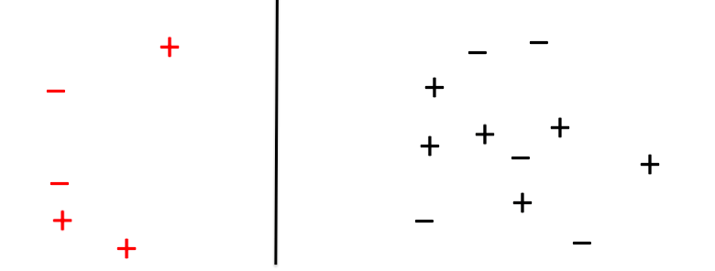
Notes:
Ok so let’s keep this image in mind here.
----
Why are those equal?
Think about it. There are only a few possibilities. If y is positive and f is positive, then we don’t make a mistake, and the top is 0. yf is positive, not negative, so the bottom is 0.
If y and f are both negative, then we don’t make a mistake, the top is 0 and and yf is positive again.
If y is positive and f is negative, then we make a mistake, we lose a point up here, and we also lose a point down here because y times f is negative.
Same thing if y is negative and f is positive.
So these logical expressions are equal to each other.

Slide 17
Notes:
This function tells us what kind of penalty we’re going to issue for being wrong. So right now if y*f is positive, it means we got it right and we lose 0 points. If we get it wrong, and the point is on the wrong side, we lose 1 point.
----
Why are those equal?
Think about it. There are only a few possibilities. If y is positive and f is positive, then we don’t make a mistake, and the top is 0. yf is positive, not negative, so the bottom is 0.
If y and f are both negative, then we don’t make a mistake, the top is 0 and and yf is positive again.
If y is positive and f is negative, then we make a mistake, we lose a point up here, and we also lose a point down here because y times f is negative.
Same thing if y is negative and f is positive.
So these logical expressions are equal to each other.

Slide 18
Notes:
I’m just going to write this function another way, which is like this. So we lose one point if yf is less than 0, and otherwise we lose no points. This is the classic 0-1 loss, just tells you whether your classifier is right or wrong. This is called a loss function. There are other loss functions too. This one is nice but it’s problematic because it’s not smooth, and we have issues with things that are not smooth in machine learning. Let’s try some more loss functions. While we’re doing this…
----
Why are those equal?
Think about it. There are only a few possibilities. If y is positive and f is positive, then we don’t make a mistake, and the top is 0. yf is positive, not negative, so the bottom is 0.
If y and f are both negative, then we don’t make a mistake, the top is 0 and and yf is positive again.
If y is positive and f is negative, then we make a mistake, we lose a point up here, and we also lose a point down here because y times f is negative.
Same thing if y is negative and f is positive.
So these logical expressions are equal to each other.

Slide 19
“sort of correct”
“very correct”
“sort of wrong”
“very wrong”
Notes:
I’m just going to write this function another way, which is like this. So we lose one point if yf is less than 0, and otherwise we lose no points. This is the classic 0-1 loss, just tells you whether your classifier is right or wrong. This is called a loss function. There are other loss functions too. This one is nice but it’s problematic because it’s not smooth, and we have issues with things that are not smooth in machine learning. Let’s try some more loss functions. While we’re doing this…
----
Why are those equal?
Think about it. There are only a few possibilities. If y is positive and f is positive, then we don’t make a mistake, and the top is 0. yf is positive, not negative, so the bottom is 0.
If y and f are both negative, then we don’t make a mistake, the top is 0 and and yf is positive again.
If y is positive and f is negative, then we make a mistake, we lose a point up here, and we also lose a point down here because y times f is negative.
Same thing if y is negative and f is positive.
So these logical expressions are equal to each other.

Slide 20
“sort of correct”
“very correct”
“sort of wrong”
“very wrong”
Notes:
Maybe we can use some other loss function. Something that maybe we get a small penalty for being sort of correct, then we get a bigger penalty for being sort of wrong, and then a big huge penalty for being very wrong. Something that looks like this.

Slide 21
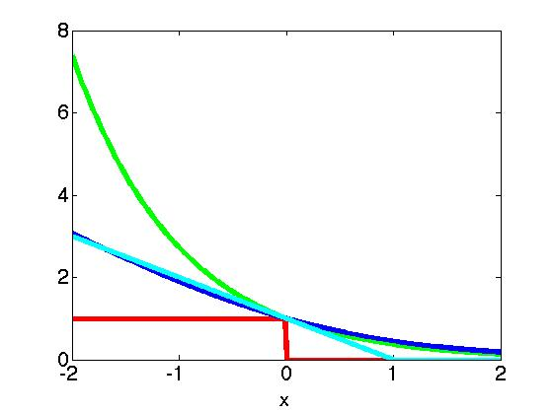
Loss Functions for Classification
Notes:
Again the horizontal axis is y times f(x). The red one is 1 if y agrees with the sign of f, and then other curves are for different algorithms.

Slide 22
Loss Functions for Classification
Incorrectly classified
Correctly classified
Notes:
Just keep in mind that On the right are points that on the correct side of the decision so they don’t suffer much penalty and on the left are points that are incorrectly classified so they suffer more penalty.

Slide 23
Loss Functions for Classification
Notes:
*click*

Slide 24
Loss Functions for Classification
(AdaBoost)

Slide 25

Loss Functions for Classification
(AdaBoost)
(SVM)

Slide 26
Loss Functions for Classification
(AdaBoost)
(Logistic Regression)
(SVM)
Notes:
I’m going to write this idea about the loss functions in notation on the next slide.

Slide 27
Loss Functions for Classification
Fraction of times sign(f(x_{i})) is not y_{i}
Notes:
Start here. The accuracy is the fraction of times that signf is not equal to y which is written like this. And then we use the trick where we put the misclassified points on one side and the correct ones on the other side. And that gives us this notation that I explained earlier.

Slide 28
Loss Functions for Classification
Fraction of times sign(f(x_{i})) is not y_{i}
Notes:
And then we’ll upper bound by the loss functions. *pause* So then, What is a good way to try to reduce the misclassification error, which is the fraction of times sign(f) is not equal to y? Well, you could try to minimize the average loss. *click*

Slide 29
Loss Functions for Classification
Fraction of times sign(f(x_{i})) is not y_{i}
Notes:
So here’s your first try for a machine learning algorithm.

Slide 30
Loss Functions for Classification
Fraction of times sign(f(x_{i})) is not y_{i}
An algorithm?
Notes:
Just choose a function f to minimize the average loss. Seems like a good idea, right? Well it is, and that’s what most machine learning methods are based on. How to do this minimization over models to get the best one – that involves some optimization techniques which go on behind the scenes.
But there’s one more thing I didn’t quite tell you, which is that we want to do more than just have low training error. We want to predict well on data we *haven’t* seen before. We want to generalize to new points. And that’s why we need statistical learning theory. Because this algorithm isn’t quite right. And you’ll see why. It’s pretty good, just maybe missing some encouragement to keep the models simple and not overfit. So I’ll talk about learning theory shortly.

Slide 31
Statistical Learning Theory for Supervised Learning
Notes:
Statistical learning theory

Slide 32
Statistical Learning Theory
Ockham’s Razor: The best models are simple models that fit the data well.
William of Ockham, English frier and philosopher (1287-1347) said that among hypotheses that predict equally well, we should choose the one with the fewest assumptions.

Slide 33
Statistical Learning Theory
Ockham’s Razor: The best models are simple models that fit the data well.
1,000K
f(x)
Income
0
2000
0
Number of Businessweek clicks
Notes:
Let’s start with a basic 1d regression model.

Slide 34
Statistical Learning Theory
Ockham’s Razor: The best models are simple models that fit the data well.
1,000K
f(x)
Income
0
2000
0
Number of Businessweek clicks

Slide 35
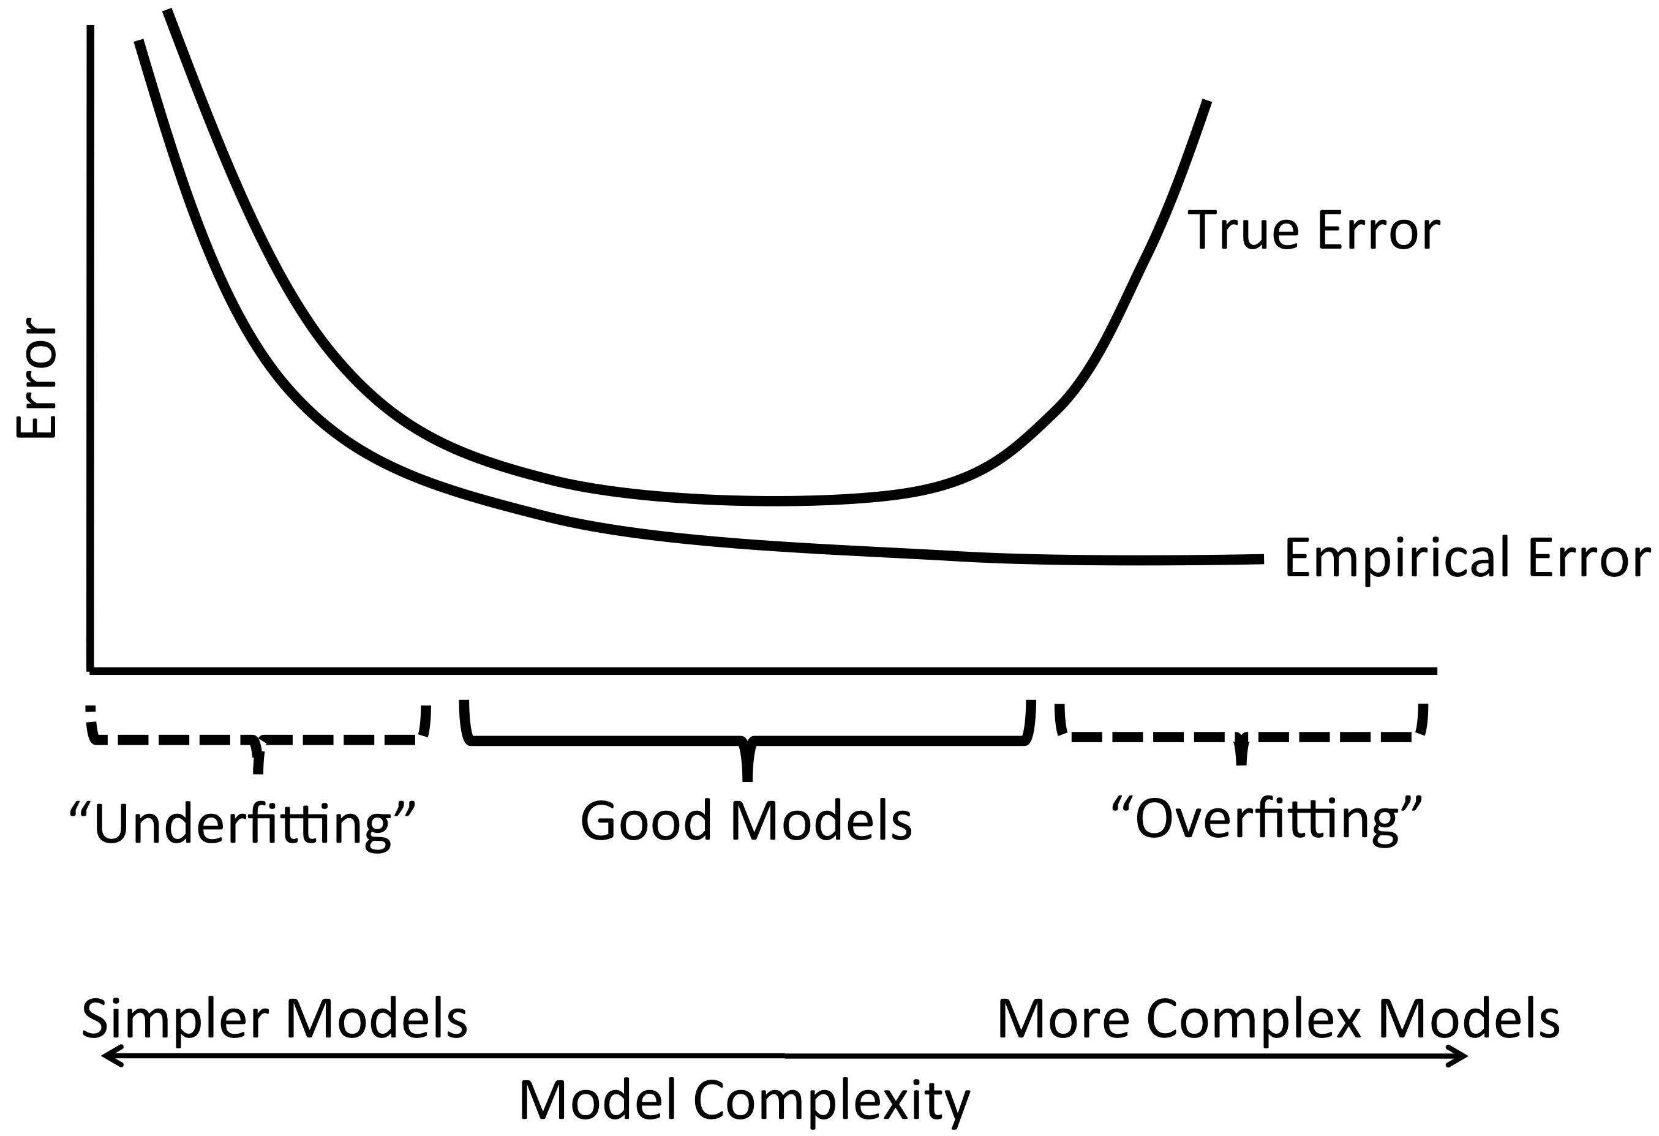
Statistical Learning Theory
Ockham’s Razor: The best models are simple models that fit the data well.
Test Error
Training Error

Slide 36
Statistical Learning Theory
Ockham’s Razor: The best models are simple models that fit the data well.
Test Error
Training Error
Notes:
True for classification, regression, etc.

Slide 37
Statistical Learning Theory
Ockham’s Razor: The best models are simple models that fit the data well.
We need a balance between accuracy and simplicity.

Slide 38
Statistical Learning Theory
Ockham’s Razor: The best models are simple models that fit the data well.
We need a balance between accuracy and simplicity.
Most common machine learning methods choose f to minimize training error and complexity.
Aims to thwart the “curse” of dimensionality.
Notes:
Occham prolly ddn’t know optimization but this would have suited him just fine I’m guessing if he were alive now.
Curse of dimensionality is that we tend to overfit when we have a lot of features and not as much data. Data needs to increase exponentially with the number of features in order not to have it.

Slide 39
To generalize, keep the model simple!
Notes:
So we’ll choose a model that is both simple and has low training error. This is the principle of occams’ razor.

Slide 40
To generalize, keep the model simple!
Principle of Ockham’s Razor: Aim for a simple and accurate explanation.
Notes:
So we’ll choose a model that is both simple and has low training error. It’s the *read*. I’ll talk more about that when we get to statistical learning theory. Anyway,

Slide 41
To generalize, keep the model simple!
Principle of Ockham’s Razor: Aim for a simple and accurate explanation.
Notes:
And simplicity is measured in several different ways, and it’s usually called regularization in ML. So this is the main foundation of ML. It’s all about creating functions that minimize the loss and keep the model simple. That’s the bottom line folks. And we’ll do this in many different ways throughout the course. Different ML methods have different loss functions and different regularization terms, So as we go on you’ll see more about what’s inside these machine learning methods because I’ll tell you what these terms are.

Slide 42
Basic Outline for ML

Slide 43
Basic Outline for Machine Learning
Step 1: Split data randomly into training and test sets.
Step 2: Estimate coefficients / Train model:
Step 3: Score model:
Compute score for each x_{i} in the test set
Step 4: Evaluate model.
Notes:
Estimate coefficients by minimizing the negative log likelihood of the data given the model. Or if you prefer the first description, minimize the loss function.

Slide 44
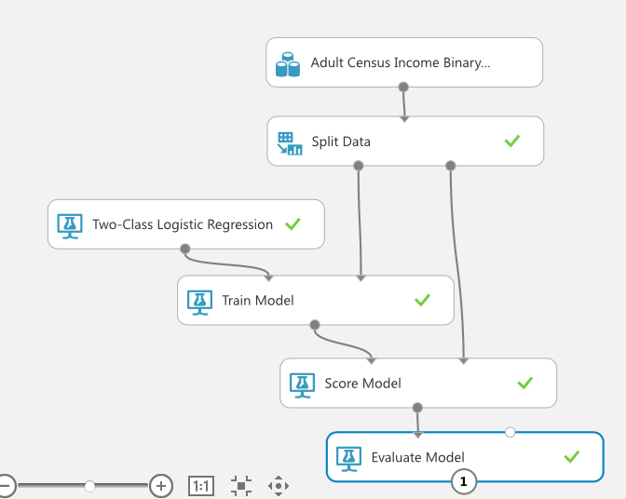
Notes:
Step 1: split it into training and test
Step 2: train the model, and we picked logistic regression for that one. Then we scored the model in step 3, and then evaluate in Step 4. And that’s a super quick and easy way to do machine learning.

Slide 45
Coming Up
Coming Up
Notes:
Step 1: split it into training and test
Step 2: train the model, and we picked logistic regression for that one. Then we scored the model in step 3, and then evaluate in Step 4. And that’s a super quick and easy way to do machine learning. There are lots of variations and extra things you can do, for instance, you can fiddle with the parameters of the model if it has any, and azure ML has a simple way to do that for instance.

Slide 46
Notes:
Including all of the ways we enumerated in the data science course.

Slide 47
Logistic Regression

Slide 48
Logistic Regression
Simple
Fast
Often competes with the best ML algorithms
Notes:
I want to talk about one very basic method in particular, which is a very old algorithm. Dates back at least 50 years. But it really works! You won’t be disappointed in this algorithm, it’s good.

Slide 49
Logistic Regression
(Logistic Regression)

Slide 50
Logistic Regression
(Logistic Regression)

Slide 51
Logistic Regression
Notes:
Where the 3 is the beta 1 and x1 is the number of hours they work per week,
We know x, we need to figure out beta. The 3 and the 4, we don’t know them in advance, we have to learn them.

Slide 52
Logistic Regression
Notes:
Where the 3 is the beta 1 and x1 is the number of hours they work per week,
We know x, we need to figure out beta. The 3 and the 4, we don’t know them in advance, we have to learn them.

Slide 53
Logistic Regression
Notes:
This is what logistic regression does, no more no less. It chooses the coefficients, the betas, to minimize this thing.

Slide 54
Logistic Regression
Notes:
Putting that in the corner for now, I want to give you another perspective on logistic regression, which is the maximum likelihood perspective. You can skip this if you’re not interested and nothing bad is going to happen, but it might be useful for some of you. Look at this function.

Slide 55
Logistic Regression
(Another perspective)
Notes:
Putting that in the corner for now, I want to give you another perspective on logistic regression, which is the maximum likelihood perspective. You can skip this if you’re not interested and nothing bad is going to happen, but it might be useful for some of you. Look at this function.

Slide 56
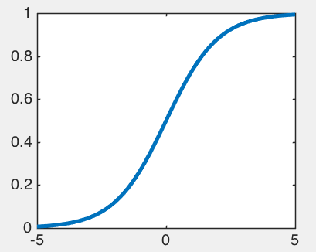
Logistic Regression
Notes:
What does this function look like to you. It looks like something growing and then saturating. This function is called the logistic function, and it was one of the very early population models, invented by Adolph Quetelet and his pupil Pierre Francois Verhulst somewhere in the mid 19th century. They were modeling growth of populations, and they were thinking that when a country gets full, the population won’t grow as much and it’ll saturate which is why it looks like that. This sounds kind of funny, but that’s what they were doing. See? Here’s when the country is just growing, and here’s when it’s full and the population won’t grow any more. Anyway, how does this relate to logistic regression? Well, it does. What do you know about probabilities. They don’t go below 0 and they don’t go above 1. So you can take any number you like, and send it through this function, which is called the logistic function by the way, and it’ll give you a probability.

Slide 57
Logistic Regression
Logistic Function
Notes:
So there’s the formula. When t is really big then e^t is much bigger than 1, so the 1 basically get ignored and you get 1. If t is really small, then the top goes to 0 and the bottom goes to 1 and you get 0. Ok so again, where does logistic regression come in?

Slide 58
Logistic Regression
Logistic Function
Notes:
Now here’s where it enters logistic regression. Let’s model the probability that the outcome is Y for a given x and beta like this. Why would we do this? It looks like a complicated function. Where did I get this? So here’s the trick. The thing on the left is a probability. So the thing on the right had better be a probability. And guess what we know it is. It’s just the logistic function. The logistic function only produces probabilities. So now this model makes sense. That’s why I want to model a probability like this.

Slide 59
Logistic Regression
Logistic Function
Notes:
Matrix notation

Slide 60
Logistic Regression

Slide 61
Logistic Regression
Notes:
I am going to need to calculate the likelihood of all the data, which is the probability to observe the label y_i that I actually observed, given its x and the model beta. And I’m almost there already.

Slide 62
Logistic Regression

Slide 63
Logistic Regression

Slide 64
Logistic Regression

Slide 65
Logistic Regression

Slide 66

Logistic Regression

Slide 67
Logistic Regression
Notes:
Just adding a little space there.

Slide 68
Logistic Regression

Slide 69
Logistic Regression
Notes:
This equals this which equals this which equals that. So I can summarize there and start with a fresh page.

Slide 70
Logistic Regression

Slide 71
Logistic Regression

Slide 72
Logistic Regression

Slide 73
Logistic Regression

Slide 74
Logistic Regression
Notes:
The 1/n is just a constant, so it doesn’t matter because it’s not involved in the optimization. And then if you expand the matrix notation out, you get exactly the same thing. These two expressions are exactly the same. Cool. So I derived logistic regression a different way. So why do I care? Why do I need this other derivation when I have the first one? The answer is really neat. It’s because

Slide 75
Logistic Regression
Notes:
Now you have this. Remember this? It’s the logistic function.

Slide 76
Logistic Regression
Notes:
But now it provides a *probabilistic* interpretation of the model. Whatever score the model gives the observation, now you get the probability that y=1 given x. You don’t just get a classification. Maybe I can show it geometrically another way.

Slide 77
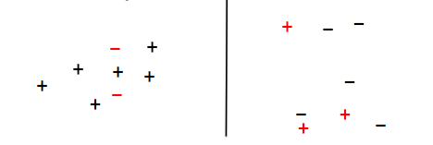
Logistic Regression
Notes:
But now it provides a *probabilistic* interpretation of the model. Whatever score the model gives the observation, now you get the probability that y=1 given x. You don’t just get a classification. Maybe I can show it geometrically another way.

Slide 78
Logistic Regression
Notes:
*read* over here you get a high probability estimate, over here it’s low.

Slide 79
Logistic Regression
Step 1: Split data randomly into training and test sets.
Step 2: Estimate coefficients / Train model:
Step 3: Score model:
Compute score for each x_{i} in the test set
Step 4: Evaluate model.
Notes:
Ok so just a summary here.

Slide 80
Notes:
And again this is just the basic version in azure ML. This is all the programming, I just literally moved the modules there and put the connectors on them and clicked “run” and that was it.

Slide 81
Logistic Regression
Improving performance through regularization (a preview!)
Notes:
Constant C

Slide 82
Logistic Regression
Improving performance through regularization (a preview!)
Notes:
Constant C

Slide 83
Logistic Regression
Improving performance through regularization (a preview!)
Notes:
In practice these two kinds of regularization have different meaning and change the coefficients in different ways, but they are both helpful for purposes of generalization.

Slide 84
Evaluation Measures for Classifiers

Slide 85
Classification
Manhole 1: [ 5 3 120 12 1 0 ….. ] -1 -22.1 -1
Manhole 2: [ 0 0 89 5 1 1 ….. ] 1 17.2 1
Manhole 3: [ 1 0 20 0 0 1 ….. ] -1 5.2 1
: : : : :
Labels, y
Features, called x
f(x)
Predicted Labels, ŷ
Notes:
Each observation is represented by a set of numbers (features).
and each observation is labeled.

Slide 86
Classification
Manhole 1: [ 5 3 120 12 1 0 ….. ] -1 -22.1 -1
Manhole 2: [ 0 0 89 5 1 1 ….. ] 1 17.2 1
Manhole 3: [ 1 0 20 0 0 1 ….. ] -1 5.2 1
: : : : :
Labels, y
Features, called x
f(x)
Predicted Labels, ŷ
Notes:
Each observation is represented by a set of numbers (features).
and each observation is labeled.

Slide 87
Classification
Manhole 1: [ 5 3 120 12 1 0 ….. ] -1 -22.1 -1
Manhole 2: [ 0 0 89 5 1 1 ….. ] 1 17.2 1
Manhole 3: [ 1 0 20 0 0 1 ….. ] -1 5.2 1
: : : : :
Labels, y
Features, called x
f(x)
Predicted Labels, ŷ
Notes:
Then the ML algorithm comes along and gives a number to each observation, which is sort of what it thinks is going on. The number says how far away from the decision boundary the observation is, and also the sign of f is the predicted label. So we’ll put those in another column.

Slide 88
Classification
Manhole 1: [ 5 3 120 12 1 0 ….. ] -1 -22.1 -1
Manhole 2: [ 0 0 89 5 1 1 ….. ] 1 17.2 1
Manhole 3: [ 1 0 20 0 0 1 ….. ] -1 5.2 1
: : : : :
Labels, y
Features, called x
f(x)
Predicted Labels, ŷ
Notes:
The Yhat is sign of f(x). Just tells you which side of the decision boundary the point is on. If the classifier is right, then yhat agrees with y.

Slide 89
Classification
Manhole 1: [ 5 3 120 12 1 0 ….. ] -1 -22.1 -1
Manhole 2: [ 0 0 89 5 1 1 ….. ] 1 17.2 1
Manhole 3: [ 1 0 20 0 0 1 ….. ] -1 5.2 1
: : : : :
Labels, y
Features, called x
f(x)
Predicted Labels, ŷ
Notes:
So let’s just look at these two columns for a few minutes. If the classifiers is really good, the predicted labels often agree with the true labels.

Slide 90
Classification
Manhole 1: [ 5 3 120 12 1 0 ….. ] -1 -22.1 -1
Manhole 2: [ 0 0 89 5 1 1 ….. ] 1 17.2 1
Manhole 3: [ 1 0 20 0 0 1 ….. ] -1 5.2 1
: : 1 : -1
-1 -1
1 -1
Features, called x
f(x)
Labels, y
Predicted Labels, ŷ
Notes:
Let’s give a few more examples, just for fun.

Slide 91
Classification
Manhole 1: [ 5 3 120 12 1 0 ….. ] -1 -22.1 -1
Manhole 2: [ 0 0 89 5 1 1 ….. ] 1 17.2 1
Manhole 3: [ 1 0 20 0 0 1 ….. ] -1 5.2 1
: : 1 : -1
-1 -1
1 -1
True Positive
Features, called x
f(x)
Labels, y
Predicted Labels, ŷ

Slide 92
Classification
True Negative
Manhole 1: [ 5 3 120 12 1 0 ….. ] -1 -22.1 -1
Manhole 2: [ 0 0 89 5 1 1 ….. ] 1 17.2 1
Manhole 3: [ 1 0 20 0 0 1 ….. ] -1 5.2 1
: : 1 : -1
-1 -1
1 -1
True Positive
Features, called x
f(x)
Labels, y
Predicted Labels, ŷ

Slide 93
Classification
True Negative
Manhole 1: [ 5 3 120 12 1 0 ….. ] -1 -22.1 -1
Manhole 2: [ 0 0 89 5 1 1 ….. ] 1 17.2 1
Manhole 3: [ 1 0 20 0 0 1 ….. ] -1 5.2 1
: : 1 : -1
-1 -1
1 -1
True Positive
(“Type I”)
False Positive
Features, called x
f(x)
Labels, y
Predicted Labels, ŷ
Notes:
You think it’s positive but it’s actually not.

Slide 94
Classification
True Negative
Manhole 1: [ 5 3 120 12 1 0 ….. ] -1 -22.1 -1
Manhole 2: [ 0 0 89 5 1 1 ….. ] 1 17.2 1
Manhole 3: [ 1 0 20 0 0 1 ….. ] -1 5.2 1
: : 1 : -1
-1 -1
1 -1
True Positive
(“Type I”)
False Positive
(“Type II”)
False Negative
Features, called x
f(x)
Labels, y
Predicted Labels, ŷ
Notes:
You think it’s negative but it’s actually not.
And then below it is another true negative and below that is another false negative, and so on.

Slide 95
Classification
True Negative
Manhole 1: [ 5 3 120 12 1 0 ….. ] -1 -22.1 -1
Manhole 2: [ 0 0 89 5 1 1 ….. ] 1 17.2 1
Manhole 3: [ 1 0 20 0 0 1 ….. ] -1 5.2 1
: : 1 : -1
-1 -1
1 -1
True Positive
(“Type I”)
False Positive
(“Type II”)
False Negative
Features, called x
f(x)
Labels, y
Predicted Labels, ŷ
Notes:
So errors come in these two flavors. Now how can we judge the quality of a classifier?

Slide 96
Confusion Matrix
 | y=+1 | y=-1
ŷ=1 | 723 | 15
ŷ=-1 | 72 | 409

Slide 97
Confusion Matrix
 | y=+1 | y=-1
ŷ=1 | 723 | 15
ŷ=-1 | 72 | 409
 | y=+1 | y=-1
ŷ=1 | TP | FP (Type I)
ŷ=-1 | FN (Type II) | TN

Slide 98
Evaluation Measures for Classifiers
Misclassification error
Notes:
Also called the classification error. Also called the misclassification rate

Slide 99
Evaluation Measures for Classifiers
Misclassification error
 | y=+1 | y=-1
ŷ=1 | TP | FP
ŷ=-1 | FN | TN
Notes:
Note that this is just 1 minus accuracy. So sometimes people say they are using accuracy and they mean the misclassification error. It’s the same calculation.

Slide 100
Evaluation Measures for Classifiers
True Positive Rate (TPR), Sensitivity, Recall
 | y=+1 | y=-1
ŷ=1 | TP | FP
ŷ=-1 | FN | TN

Slide 101
Evaluation Measures for Classifiers
True Negative Rate (TNR), Specificity
 | y=+1 | y=-1
ŷ=1 | TP | FP
ŷ=-1 | FN | TN
Notes:
Note that this is just 1 minus accuracy. So sometimes people say they are using accuracy and they mean the misclassification error. It’s the same calculation.

Slide 102
Evaluation Measures for Classifiers
False Positive Rate (FPR)
 | y=+1 | y=-1
ŷ=1 | TP | FP
ŷ=-1 | FN | TN
Notes:
Note that this is just 1 minus accuracy. So sometimes people say they are using accuracy and they mean the misclassification error. It’s the same calculation.

Slide 103
Evaluation Measures for Classifiers
Precision
 | y=+1 | y=-1
ŷ=1 | TP | FP
ŷ=-1 | FN | TN
Notes:
Note that this is just 1 minus accuracy. So sometimes people say they are using accuracy and they mean the misclassification error. It’s the same calculation.

Slide 104
Evaluation Measures for Classifiers
Precision
F1-score
 | y=+1 | y=-1
ŷ=1 | TP | FP
ŷ=-1 | FN | TN
Recall
 | y=+1 | y=-1
ŷ=1 | TP | FP
ŷ=-1 | FN | TN
Notes:
It’s amazing how many different ways people commonly measure things, out of only 4 numbers. Once you have that confusion matrix, you can compute any of them that you like.

Slide 105
Information Retrieval
Precision@N for a search query: Of the top N pages received, how many relevant?
Recall@N for a search query: If there are N=#Pos relevant webpages, what fraction did our query return?

Slide 106
Which one?
Standard ML: Misclassification Error (or Accuracy)
Doctors: Sensitivity and Specificity (TPR and TNR)
Info Retrieval: Precision & Recall, F1-score
Notes:
The Machine Learners use accuracy just because it’s one number that you can directly compare across algorithms. You need a single measure of quality to compare algorithms. Once you have 2 measures of quality you can’t directly make a comparison, because what if one algorithm is better according to one quality measure but not to another one? Then you can’t compare them. But this only works when errors for the positive class count equally to errors for the negative class. This doesn’t work when the data are imbalanced, but anyway, that’s what they do.
Doctors want to know how many of the positives they got right *and* how many of the negatives they got right. That makes sense. They want to look at both of them.
If you’re in info retrieval, then precision and recall make sense. Let’s say you are judging the quality of a search engine, say Bing for instance. You might care about the precision. Of the web pages the engine returned, how many really were relevant? That’s precision. And recall is the fraction of relevant webpages that the search engine returned. And then they use F1score so it’s a single measure and they can compare the quality of different search engines in an easy way.

Slide 107
Which one?
Standard ML: Misclassification Error (or Accuracy)
Doctors: Sensitivity and Specificity (TPR and TNR)
Info Retrieval: Precision & Recall, F1-score
Notes:
The Machine Learners use accuracy just because it’s one number that you can directly compare across algorithms. You need a single measure of quality to compare algorithms. Once you have 2 measures of quality you can’t directly make a comparison, because what if one algorithm is better according to one quality measure but not to another one? Then you can’t compare them. But this only works when errors for the positive class count equally to errors for the negative class. This doesn’t work when the data are imbalanced, but anyway, that’s what they do.
Doctors want to know how many of the positives they got right *and* how many of the negatives they got right. That makes sense. They want to look at both of them.
If you’re in info retrieval, then precision and recall make sense. Let’s say you are judging the quality of a search engine, say Bing for instance. You might care about the precision. Of the web pages the engine returned, how many really were relevant? That’s precision. And recall is the fraction of relevant webpages that the search engine returned. And then they use F1score so it’s a single measure and they can compare the quality of different search engines in an easy way.

Slide 108
Which one?
Standard ML: Misclassification Error (or Accuracy)
Doctors: Sensitivity and Specificity (TPR and TNR)
Info Retrieval: Precision & Recall, F1-score
Notes:
The Machine Learners use accuracy just because it’s one number that you can directly compare across algorithms. You need a single measure of quality to compare algorithms. Once you have 2 measures of quality you can’t directly make a comparison, because what if one algorithm is better according to one quality measure but not to another one? Then you can’t compare them. But this only works when errors for the positive class count equally to errors for the negative class. This doesn’t work when the data are imbalanced, but anyway, that’s what they do.
Doctors want to know how many of the positives they got right *and* how many of the negatives they got right. That makes sense. They want to look at both of them.
If you’re in info retrieval, then precision and recall make sense. Let’s say you are judging the quality of a search engine, say Bing for instance. You might care about the precision. Again precision is: Of the web pages the engine returned, how many really were relevant? That’s precision. And recall is the fraction of relevant webpages that the search engine returned. And then they use F1score so it’s a single measure and they can compare the quality of different search engines in an easy way.

Slide 109
ROC Curves

Slide 110
ROC Curves
Started during WWII for analyzing radar signals.
For a particular False Positive Rate (FPR), what is the True Positive Rate (TPR)?
FPR = number of negatives that were classified by the ML algorithm as positives / total number of negatives
TPR = number of positives that were classified by the ML algorithm as positives / total number of positives

Slide 111
ROC Curves
Adjust the decision boundary
TPR = 7/10
FPR = 3/10
+
−
+
−
−
−
+
−
+
+
+
−
−
+
+
+
+
−
−
+
−
−
Notes:
TPR is the number of actual positives classified as positives, which is 7, divided by the total number of points classified as positives, which is 10.
FPR is the number of actual negatives classified as positive. So 3 actual negatives classified as positive, and then 10 points classified as positive. But what if I chose the decision boundary a bit differently. What if I had chosen f=3 to be the boundary. Then the boundary might be over here.

Slide 112
ROC Curves
Adjust the decision boundary
TPR = 3/5
FPR = 2/5
+
−
+
−
−
−
+
−
+
+
+
−
−
+
+
+
+
−
−
+
−
−
Notes:
Then what happened.

Slide 113
ROC Curves
Adjust the decision boundary
TPR = 10/17
FPR = 7/17
+
−
+
−
−
−
+
−
+
+
+
−
−
+
+
+
+
−
−
+
−
−
Notes:
Then what happened.

Slide 114
ROC Curves
Adjust the decision boundary
TPR = 1/1
FPR = 0/1
+
−
+
−
−
−
+
−
+
+
+
−
−
+
+
+
+
−
−
+
−
−
Notes:
Ok now what if you sweep this thing down from top to bottom

Slide 115
ROC Curves
Adjust the decision boundary
+
−
+
−
−
−
+
−
+
+
+
−
−
+
+
+
+
−
−
+
−
−
Notes:
Ok now what if you sweep this thing down from top to bottom, and every time you move it you record the TPR and the FPR. Then you plot all of those TPRs and FPRs on a scatter plot, and that’s the ROC curve. Let’s do it.

Slide 116
ROC Curves
For a particular False Positive Rate (FPR), what is the True Positive Rate (TPR)?
1
TPR
0
FPR
0
1

Slide 117
ROC Curves
For a particular False Positive Rate (FPR), what is the True Positive Rate (TPR)?
1
TPR
0
FPR
0
1

Slide 118
ROC Curves
For a particular False Positive Rate (FPR), what is the True Positive Rate (TPR)?
1
TPR
ROC curve
0
FPR
0
1

Slide 119
ROC Curves
For a particular False Positive Rate (FPR), what is the True Positive Rate (TPR)?
1
TPR
AUC/AUROC
0
FPR
0
1

Slide 120
ROC Curves
For a particular False Positive Rate (FPR), what is the True Positive Rate (TPR)?
1
Be better than this line
TPR
0
FPR
0
1
Notes:
If you’re not better than that line, you might want to turn your classifier upside down so it predicts the opposite of what it’s currently doing. Because it’s worse than random guessing, which means it could be better if you flipped it. Hopefully you’ll get a curve like I showed you on the previous slide. Most of the time you don’t get perfect. Most prediction problems are not that easy.

Slide 121
Evaluation
Many ways to evaluate a model:
Confusion matrix (TP, TN, FP, FN)
Accuracy / misclassification error
Precision, Recall, F1-score
ROC curves, AUC/AUROC
Notes:
Including all of the ways we enumerated in the data science course.

